Slide 1
Management 515
Leadership
© 2014, 2016 David E. Frick.
All rights reserved.

Slide 2
Definitions
Leadership. The process by which a person exerts influence over others and inspires and directs their activities to achieve group or organizational goals
Leader.
An individual who is able to exert influence over other people to help achieve group or organizational goals
Someone who has followers
Manager. A quasi-leadership role established by formal position within an organization
Notes:
Here are some classic definitions.
I wish to emphasize the difference between a leader and a manger. In my view, leader and manager are roles. These roles are inherently in conflict. The leader wants change and the manager wants stability.
Leaders can emerge at any level. Managers only exist in formal organizational structures.
Leadership demands one thing—followers. Without followers, leaders are useless voices in the wind.
Followers can be willing or coerced. Willing followers believe in the leader, or the mission or the idea. Coerced followers will only follow as long as the coercion exists.

Slide 3
Leader Role versus Manager Role
Manages work
Manages subordinates
Achieves results
Risk averse
Involved
Relies on position and authority
Effects change
Leads followers
Risk-taking
Facilitative
Relies on charisma and influence
Dictatorial
Authoritative
Transactional
Autocratic
Consultative
Democratic
Transformational
Consultative
Participative
Leader
Manager
Notes:
You have seen this chart before.
I argue that pure managers and pure leaders do not exist in the real world.
All managers must lead from time to time and all leaders must manage once in a while. As leaders and mangers move left and right on this continuum, the mix of these tasks varies.
One person can assume both roles at the same time, however, an internal conflict then naturally exists.

Slide 4
Leadership Style
The specific ways in which a manager chooses to influence others
Shapes the way the leader approaches the other principal tasks of leadership
Leadership style has a cultural component
European managers tend to be more people-oriented than American or Japanese managers
Japanese managers are group-oriented, while U.S managers focuses more on organizational goals
Affects the leader’s view of time horizons
Notes:
Much has been written about leadership styles. Some will argue that you must do this or that, exhibit this or that characteristic, and follow certain rules at which point you will be a leader.
I suggest that you ignore these people.
Leadership styles are a function of the individual leader’s personality. What leadership style a specific leader uses is more a matter of how you define the leadership styles. No universal definitions exists.
In general, individuals are comfortable with one and only one specific set of characteristics. For the purpose of this discussion, let us call this a leadership style. Just like personality indices, leaders tend to fall into a limited member of styles which we will see in the following slides.
The better leader can adopt more than one leadership style. The best leaders can adopt many styles and apply the style that is best suited for the situation.

Slide 5
Leadership Styles
No consensus exists on the definition of leadership styles
Transactional vs. Transformational
A transactional leader is concerned with the day-to-day. A better definition is manager.
The transformational leader is concerned with change
Common view of leadership styles
Authoritative
Democratic
Charismatic
Laissez Faire
Bureaucratic
Notes:
Some will argue that leaders are wither transactional or transitional. I disagree with this bifurcation. In my mind, a transactional leader is really a manager. Feel free to disagree, but remember that in my view of the world, leaders seek change and managers seek stability. If no change is needed, then you do not have need of a leader.
The five styles listed in bullet three are the most commonly accepted. However, depending on the author of the book you are reading, hundreds of styles exist.

Slide 6
Leadership and Styles
Many styles exist, no one style is best
Most people have a preferred style
Based on personality
Most comfortable
Few people can operate in more than one style
Over time, tend to regress to preferred style
Strive to understand all leadership styles and their impact
The more flexible you are in your leadership styles, the better leader you will be
Notes:
This emphasizes what I said two slides previously. As an aspiring leaders, I would admonish you to:
--Understand how to define various leadership styles. This is not so important for the act of leading, but for your ability to communicate with others.
--Understand what leadership style with which you are most comfortable.
--Try to adopt and apply different leadership styles to different situations.

Slide 7
SUPPORTING
Praise, listen, and facilitate
For people who have
High Competence
Variable Commitment
COACHING
Direct and support
For people who have
Some Competence
Some Commitment
Low SUPPORTIVE BEHAVIOR High
EMPOWERING
Turn over responsibility for day-to-day decision making
For people who have
High Competence
High Commitment
DIRECTING
Structure, control, and supervise
For people who have
Low Competence
High Commitment
Low DIRECTIVE BEHAVIOR High
Notes:
Here is one model of leadership.
There is nothing wrong with this model, except I believe it is incomplete.

Slide 8
DOMINATOR
High on task, low on people
Big boss. Runs the show
Sets high expectations
Concerned with results
Suppresses disagreements
Gets things done
Competitive and confident
Doesn’t listen to others
COLLABORATOR
High on task and people
Sets high expectations
Concerned with results
Involves people in decisions
Deals openly with concerns
Seeks win-win solutions
Encourages responsibility
Interdependent
Low ASSERTIVENESS High
AVOIDER
Low on task and people
Keeps a low profile
Hesitant and cautions
Doesn’t want to make mistakes
Follows tried and true
Avoids conflict/disagreements
Doesn’t provide direction
Carries out what others want
ACCOMMODATOR
Low on task, high on people
Warm and friendly
Keeps people happy
Smoothes over conflicts
Easy going, overlooks mistakes
Lets others decide
Loose structure
Low EMPATHY High
Notes:
Here is another model. Same issue.

Slide 9
Strengths | Weaknesses
Commanding
Goal oriented Emphasis on bottom line Makes quick decisions Willing to take risks | Pursues big, risky challenges Makes abrupt decisions Lack of esprit de corps Lack of communication
Innovating
Idea oriented Emphasis on people Entertaining, fun Willing to take risks | Lots of ideas, goals Lack of clear priorities Difficulty with follow through Hard to gain commitment
Deliberating
Fact and process oriented Emphasis on precision Stresses academic credentials Lots of quality control | Linear thinking Unwilling to take risks Tends to miss deadlines Blind to the big picture
Caring
Relationship oriented Emphasis on team Fun, warm, friendly Loyal to the cause | Avoids conflict, change Makes decision slowly, if ever Not clear about purpose or goals Tendency towards bureaucracy
Notes:
This model is closer to the classic five, but also incomplete.

Slide 10
Innovator | Developer | Activator | Maximizer | Stabilizer
Design | Design and Build | Build | Build and Maintain | Maintain
Bringing new ideas and original solutions to the marketplace. Thinking outside the box to solve problems | Taking action on original solutions and learning along the way. Motto: Ready, aim, fire | Moving forward to achieve challenging goals. Overcoming obstacles and getting things done | Embracing the good of the past while making new changes. Working together with all kinds of people | Keeping things running smoothly and efficiently. Creating systems that meet the highest standards of accountability
Creativity | Flexibility | Tenacity | Diplomacy | Consistency
Principal Characteristic
Notes:
Same issues here. OK, but incomplete.

Slide 11
Style | Description | When to Use | Weaknesses
Commanding Coercive | Dictatorship “Do what I say” | When time is scarce or in a crisis | Members can feel stifled as they are treated as workers and not asked for an opinion
Visionary Authoritative | Mobilizes people towards vision “Come with me” | When a new direction is needed | Lacks an ability to help team members understand how they get to a goal
Affiliative | Focuses on emotional needs over work needs “People come first” | Best used for healing rifts and getting through stressful situations | Confrontation and emotionally distressing positions can be avoided
Democratic | Uses participation, listening to both the bad and the good “What do you think?” | To gain valuable input from employees and to gain buy-in when there is time to do so | Can be lots of listening, but very little effective action
Pacesetting | Builds challenging and exciting goals for people “Do as I do, now” | When the team is already highly motivated and competent | Can lack emotional intelligence
Coaching | Connecting corporate goals while helping people find strengths and weaknesses “Try this” | When individuals need to build longer term strengths | Can appear to be micromanaging
Notes:
And again.

Slide 12
Style | Definition | Style | Definition
Autocratic | Leader is in total control of the group and task. Importance is focused at the top | Laissez Faire | Leader withdraws authority and influence in favor of permissiveness
Consultative | Leader consults those affected by a decision. Those affected have a voice | Nomothetic | Leader emphasizes the requirements of the institution rather than the needs of an individual in the group
Participative | Leader and group discuss and decide together. Those affected have a voice and a vote | Idiographic | Leader emphasized the needs of an individual rather than those of the institution
Democratic | The majority opinion of the group determines the course of action | Situational | Appropriate approach is determined by the situation: traits of the leader and group and the task at hand
Notes:
The classic five plus three. Better, not perfect.
So far you have seen dozens of terms for leadership style. Some are similar, some contradictory.
Understand that no consensus exists. Nonetheless, you need to decide in which category (style) your personality falls. This will be the style that you naturally adopt.
If that style is not the best for a particular situation, not all is lost. At least you are aware and can try to adjust to a more appropriate style.

Slide 13
Servant Leader
Term coined by Robert Greenleaf in the 1970s. Emphasizes:
Social responsibility over selfishness
Service, honesty, fairness
Some claim it is the way ahead in the world
Places the needs of the employees over those of the stockholders, other stakeholders, or the firm
Antithetical to human nature
Why would a firm want a servant leader?
Seems to be an effort by leftists to taint business schools (one PhD’s opinion)
Notes:
A more recently coined style is that of servant leader.
Servant leadership is both a leadership philosophy and set of leadership practices. The servant-leader shares power, puts the needs of others first and helps people develop and perform as highly as possible.
The most common division of leadership styles is the distinction between autocratic, participative and laissez-faire leadership styles. Servant leadership can be associated most closely with the participative leadership style. The highest priority of a servant leader is to encourage, support and enable subordinates to unfold their full potential and abilities. This leads to an obligation to delegate responsibility and engage in participative decision-making.
The servant leadership approach goes beyond employee-related behavior and calls for a rethinking of the hierarchical relationship between leader and subordinates. This does not mean that the ideal of a participative style in any situation is to be enforced, but that the focus of leadership responsibilities is the promotion of performance and satisfaction of employees.
I have no objection to servant leadership, in fact, I believe it is the best style for government and philanthropic organizations. I am not convinced that it is best for business. I fall back to the adage that, “if everyone is in charge, then no one is in charge.”

Slide 14
Power
A leader only uses power through coercion
A leader with willing followers does not need power
A leader with unwilling followers must use coercion:
Physical force
Bribery
Blackmail
Threats
Deceit
In business, power is an element of the role of manager
Legitimate. The authority that a manager has by virtue of his or her position in the firm
Reward or Punishment. The ability of a manager to give or withhold tangible benefits or impose penalty
Notes:
I have addressed these concepts previously.
The leader with willing followers does not need power, or you might say that the power the leader wields is the ability to positively influence others.
If you need to wield power in the form of rewards or punishment, then you are acting like a manager.

Slide 15
Sources of Managerial Power
Coercive
Expert
Relevant
Notes:
One model holds that power comes in three flavors.
I would argue that expert and relevant power can be exercised by a leader, but coercive power falls within the toolkit of the manager.
How you view power is up to you, just be aware that not all power is the same.

Slide 16
Coercive Power
The ability to punish others
Limited in effectiveness and application. Can have serious negative effects on morale and performance
Ways for managers to exercise coercive power in business
Reprimands
Adverse personnel actions
Pay adjustments
Adjustments to benefits
Reassignment
Dismissal
Notes:
If you msut use coercive poer, you are a manager or a very bad leader.
Yes, power does flow from the end of a gun, but it does not develop willing followers.

Slide 17
Expert Power
Power that is based on special knowledge, skills, and expertise
Special knowledge
Skills
Abilities
Expertise
Tends to be used in a guiding or coaching
Notes:
Expert power flows form the leaders ability to convince followers that the leader knows best.

Slide 18
Relevant Power
Power that is derived from subordinates’ and peers’
Respect
Admiration
Loyalty
Trust
Possessed by managers who are respected, liked, and whom subordinates hold as a role model
Relevant power is most often associated with leaders. We follow because of a belief in the leader or the cause
Notes:
This is more akin to charisma or the power of personality.

Slide 19
Leadership Traits
Intelligence
Expertise
Dominance
High energy
Self-confidence
Honesty
Integrity
Tolerance for stress
Maturity
Notes:
Most authors will tell you that good leaders must exhibit these characteristics. In the U.S. military, the leadership manuals tell us that these characteristics are essential for the officer corps.
Having grown up in that environment, I can agree that in the specific realm of military operations, an officer who does not exhibit these characteristics will fail. I am not convinced that these characteristics are all vital in business.
No consensus exists on what is the right set of leadership characteristics. I do not believe that such a definition is necessary. Many successful leaders have lacked many of these characteristics.
As an example, I (as an individual) will not follow someone who is not honest. On the other hand, 62% of supporters of Hilary Clinton admit that she is not honest, yet they will vote for her.
What is important depends on the individual.

Slide 20
Nurture vs. Nature
Anyone can be a leader
All you need to lead is followers
Leaders exist at all levels
Leaders are formal or informal
Formal leaders often have a management role
Informal leaders are those people who inspire others to get things done
I can teach you the academic skills, but…
For some critical leadership traits, you either have them or you don’t
These traits differentiate bad from good from great
Notes:
Some final thoughts…

Slide 21
Good Leaders…
Lead by example. Always do the right thing, even when it is hard, and insist that others do likewise
Are passionate about the mission. A leader without passion will lose followers. Honest passion can inspire others.
Possesses strong organizational skills. A disorganized leader is chasing his own tail. Disorganization breeds disorganization, and therefore, inefficiency.
Delegate. First, you can’t do everything. Second, a great leader creates other leaders through delegation. This is an argument for servant leadership

Slide 22
Good Leaders…
Never deny responsibility. Even though you delegated work to a subordinate, the ultimate responsibility still rests with you.
Communicate effectively. The leaders primary task is effecting change. This demands the ability to clearly convey a vision in many media and in ways to reach everyone.
Are honest. Bad news never gets better with age. Good leaders do not obfuscate.

Slide 23
Good Leaders…
Are good listeners. Part of being a good communicator is being a good listener. If all you want to do is talk, you are not leading. When you listen more, you get to the heart of things much faster.
Know their people. Keeping track of names, birthdays, marriages, and children pays huge dividends with some subordinates. Those with the natural ability are truly blessed. The rest of us need to write things down.
Are often followers. If you are leading without following, you’re a dictator. A leader-follower finds value in the team, and inspires the team to higher performance.
Notes:
Here is another model of leadership. I do necessarily agree with this model, but I want you to watch them to form your own opinion.
Dr. Maxwell, in my opinion, confuses the line between leadership and management, but he has a good message.
John Maxwell: https://www.youtube.com/watch?v=aPwXeg8ThWI

Slide 24
Another View
General Kurt Gebhard Adolf Philipp Freiherr von Hammerstein-Equord.
“I divide my officers into four classes as follows: The clever, the industrious, the lazy, and the stupid. Each officer possesses two of these qualities. The man who is clever and industrious, I appoint to the general staff. The man who is clever and lazy is destined for high command because he has the nerve to deal with all situations. Use can, under certain circumstances, be made of the stupid and lazy. But, whoever is stupid and industrious must be got rid of at once”
Notes:
This German General was the German Army Chief of the General Staff during WWI. In his view, the best leader is clever and lazy.
I cannot argue against his position. I suspect most authors of books on management would argue against lazy, but I see the general’s point.
Now, the general was talking about picking the right jobs for different officers, but I find it interesting that the general wants the industrious to serve on the staff (to be managers) and the lazy to be leaders.
If you only need a leader which you need change, then the lazy leader will pick the path of least resistance to change.
Please feel free to disagree with me.

Slide 25
Sex and Leadership
The number of women managers is rising but is still relatively low in the top levels of management
Historical experience suggests that men and women are different. Politically incorrect, but true
Women are nurturing, supportive, and concerned with interpersonal relations
Men are task-focused
For task-oriented endeavors, e.g., manufacturing, men may be a better fit
For people-oriented endeavors, e.g., knowledge work, women may be a better fit
Notes:
Politicians seeking votes will argue that women suffer discrimination in the business world and only the politician can fix it. This is garbage.
I argue that women are less prevalent in senior management roles for many reasons that have nothing to do with discrimination:
--Self-selection. Women tend to select job roles that do not lead to senior management, e.g., child care, health care.
--Child bearing. When women temporarily leave the job market to bear children, they fall behind their male peers in competing for advancement
--The last hundred years of U.S. industry has demanded task-focused skills. Men tend to have a greater aptitude for task-focused leadership styles
I also argue that times are changing and the need for participative management is increasing. Women are better suited for this leadership style. All things being equal, I predict that in the next 50 years, more women will be in senior executive roles then men in the United States.
Does the “good ole boy network” still exist (where men executives favor their men friends over women for promotion)? Yes, I admit it, it does, but it is not as prevalent as many politicians claim.

Slide 26
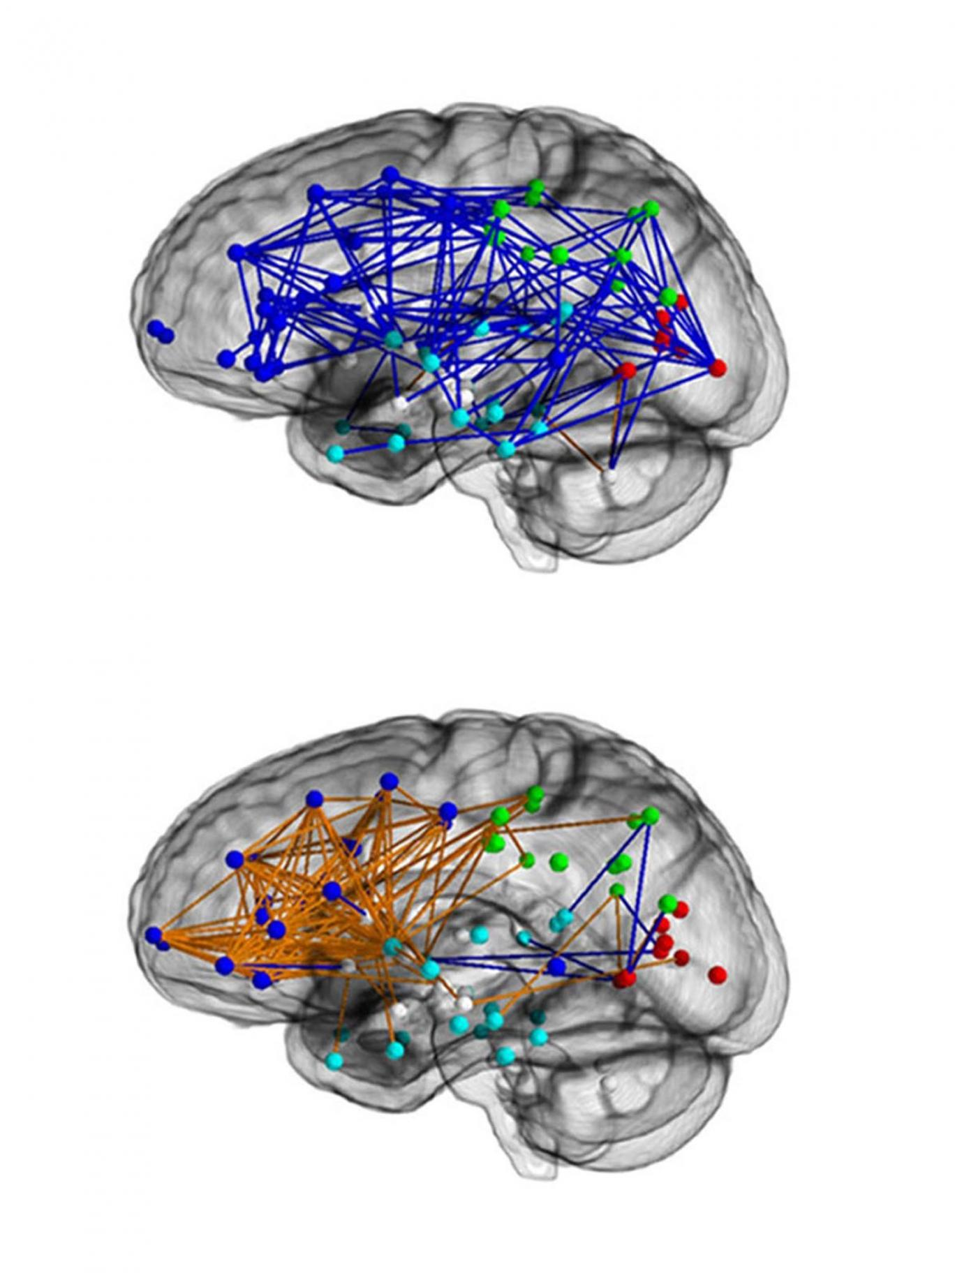
Physical differences
Male brain
More intra-hemisphere connections
Better spatial skills
Better motor skills
10% larger than female brain
8% more grey matter
Female brain
More inter-hemisphere connections
7% more white matter
Better verbal skills
More intuitive
Notes:
Male brain
Ten percent larger
Eight percent more grey matter
More inter-hemisphere connections
Female brain
Seven percent more white matter
More interconnections in the frontal lobes

Slide 27
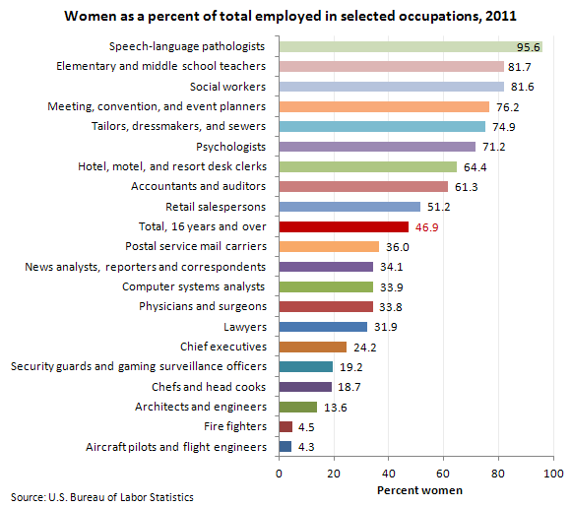
Different choices

